Slide 1
Fundamentals of Computer Vision and its Applications
Course Code and Name: UCS655 - AI Applications

Slide 2
Where are we in Syllabus
Fundamentals of Computer Vision and its applications:
1. Introduction and goal of computer vision
2. Basics of image processing and formation
3. Convolutional neural network
4. Use cases: Face Recognition, Self-Driving Cars, Video Surveillance for Traffic

Slide 3
Basics of Image Processing and Formation

Slide 4
What is Image Processing?
Digital Image Processing means processing digital image by means of a digital computer.
Image processing mainly include the following steps:
1.Importing the image via image acquisition tools; 2.Analysing and manipulating the image; 3.Output in which result can be altered image or a report which is based on analyzing that image.

Slide 5
What is an image?
An image is defined as a two-dimensional function,F(x,y), where x and y are spatial coordinates, and the amplitude of F at any pair of coordinates (x,y) is called the intensity of that image at that point. When x,y, and amplitude values of F are finite, we call it a digital image.
Digital Image is composed of a finite number of elements, each of which elements have a particular value at a particular location.
These elements are referred to as picture elements, image elements, and pixels.
A Pixel is most widely used to denote the elements of a Digital Image.

Slide 6
Types of an Image
BINARY IMAGE– The binary image as its name suggests, contain only two pixel elements i.e 0 & 1,where 0 refers to black and 1 refers to white. This image is also known as Monochrome.
BLACK AND WHITE IMAGE– The image which consist of only black and white color is called BLACK AND WHITE IMAGE.
8 bit COLOR FORMAT– It is the most famous image format. It has 256 different shades of colors in it and commonly known as Grayscale Image. In this format, 0 stands for Black, and 255 stands for white, and 127 stands for gray.
16 bit COLOR FORMAT– It is a color image format. It has 65,536 different colors in it. It is also known as High Color Format. In this format the distribution of color is not as same as Grayscale image.
A 16 bit format is actually divided into three further formats which are Red, Green and Blue. That famous RGB format.

Slide 7
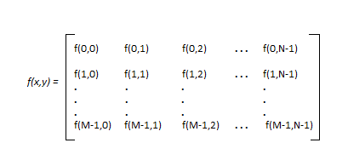
Image as a Matrix
Images are represented in rows and columns we have the following syntax in which images are represented:
The right side of this equation is digital image by defintion. Every element of this matrix is called image element , picture element , or pixel.

Slide 8
Phases of Image Processing
1.ACQUISITION– It could be as simple as being given an image which is in digital form. The main work involves: a) Scaling b) Color conversion(RGB to Gray or vice-versa)
2.IMAGE ENHANCEMENT– It is amongst the simplest and most appealing in areas of Image Processing. It is also used to extract some hidden details from an image and is subjective.
3.IMAGE RESTORATION– It also deals with appealing of an image but it is objective(Restoration is based on mathematical or probabilistic model or image degradation).
4.COLOR IMAGE PROCESSING– It deals with pseudo-color and full color image processing. Color models are applicable to digital image processing.
5.WAVELETS AND MULTI-RESOLUTION PROCESSING– It is foundation of representing images in various degrees.

Slide 9
Phases of Image Processing – Contd.
6.IMAGE COMPRESSION-It involves in developing some functions to perform this operation. It mainly deals with image size or resolution.
7.MORPHOLOGICAL PROCESSING-It deals with tools for extracting image components that are useful in the representation & description of shape.
8.SEGMENTATION PROCEDURE-It includes partitioning an image into its constituent parts or objects. Autonomous segmentation is the most difficult task in Image Processing.
9.REPRESENTATION & DESCRIPTION-It follows output of segmentation stage, choosing a representation is only the part of solution for transforming raw data into processed data.
10.OBJECT DETECTION AND RECOGNITION-It is a process that assigns a label to an object based on its descriptor.

Slide 10
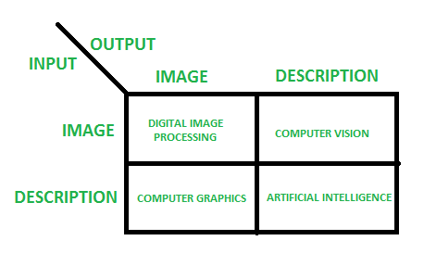
Overlapping fields with Image Processing
According to block 1,if input is an image and we get out image as a output, then it is termed as Digital Image Processing.
According to block 2,if input is an image and we get some kind of information or description as a output, then it is termed as Computer Vision.
According to block 3,if input is some description or code and we get image as an output, then it is termed as Computer Graphics.
According to block 4,if input is description or some keywords or some code and we get description or some keywords as a output, then it is termed as Artificial Intelligence

Slide 11
Image Edge Detection Operators
Edges are significant local changes of intensity in a digital image. An edge can be defined as a set of connected pixels that forms a boundary between two disjoint regions. There are three types of edges:
Horizontal edges
Vertical edges
Diagonal edges

Slide 12
Edge Detection is a method of segmenting an image into regions of discontinuity. It is a widely used technique in digital image processing like
pattern recognition
image morphology
feature extraction

Slide 13
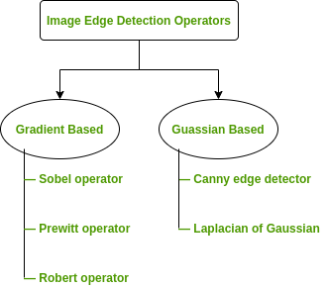
Edge detection allows users to observe the features of an image for a significant change in the gray level. This texture indicating the end of one region in the image and the beginning of another. It reduces the amount of data in an image and preserves the structural properties of an image.
Edge Detection Operators are of two types:
Gradient – based operator which computes first-order derivations in a digital image like, Sobel operator, Prewitt operator, Robert operator
Gaussian – based operator which computes second-order derivations in a digital image like, Canny edge detector, Laplacian of Gaussian

Slide 14
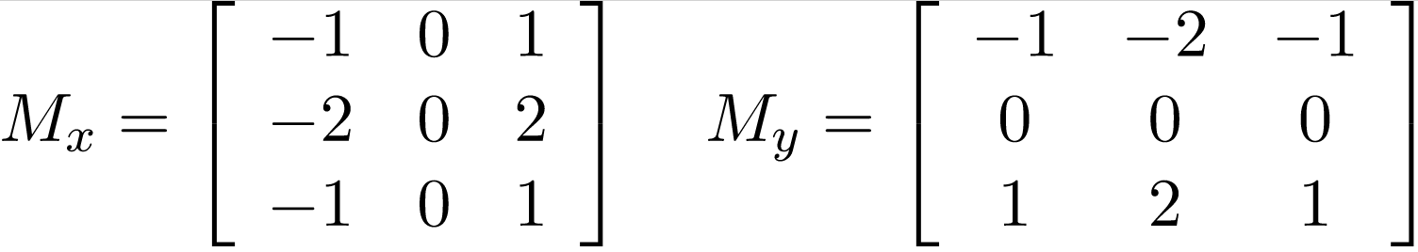
Sobel Operator
It is a discrete differentiation operator.
It computes the gradient approximation of image intensity function for image edge detection.
At the pixels of an image, the Sobel operator produces either the normal to a vector or the corresponding gradient vector.
It uses two 3 x 3 kernels or masks which are convolved with the input image to calculate the vertical and horizontal derivative approximations respectively –

Slide 15
Advantages and Limitations of Sobel Operator
Advantages:
Simple and time efficient computation
Very easy at searching for smooth edges
Limitations:
Diagonal direction points are not preserved always
Highly sensitive to noise
Not very accurate in edge detection
Detect with thick and rough edges does not give appropriate results

Slide 16
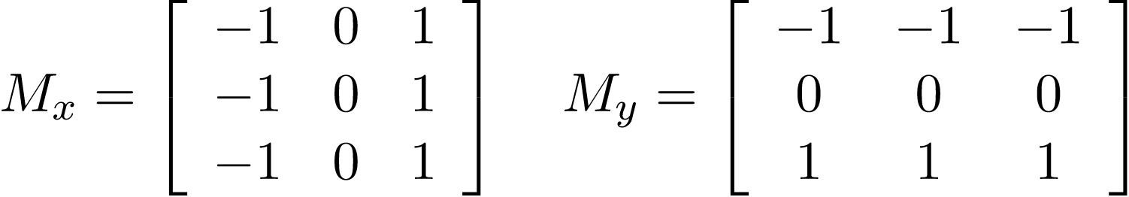
Prewitt Operator
This operator is almost similar to the sobel operator.
It also detects vertical and horizontal edges of an image.
It is one of the best ways to detect the orientation and magnitude of an image. It uses the kernels or masks –

Slide 17
Advantages and Limitations of Prewitt Operator
Advantages:
Good performance on detecting vertical and horizontal edges
Best operator to detect the orientation of an image
Limitations:
The magnitude of coefficient is fixed and cannot be changed
Diagonal direction points are not preserved always

Slide 18
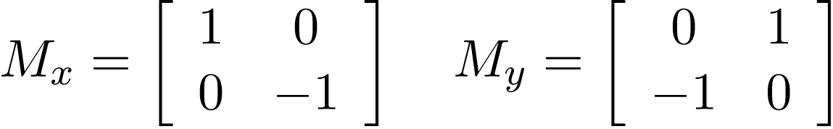
Robert Operator
This gradient-based operator computes the sum of squares of the differences between diagonally adjacent pixels in an image through discrete differentiation.
Then the gradient approximation is made. It uses the following 2 x 2 kernels or masks –

Slide 19
Advantages and Limitations of Robert Operator
Advantages:
Detection of edges and orientation are very easy
Diagonal direction points are preserved
Limitations:
Very sensitive to noise
Not very accurate in edge detection

Slide 20
Real world applications of Image Edge Detection
Medical imaging, study of anatomical structure
Locate an object in satellite images
Automatic traffic controlling systems
Face recognition, and fingerprint recognition

Slide 21
References
Digital Image Processing Basics - GeeksforGeeks
Image Edge Detection Operators in Digital Image Processing - GeeksforGeeks

Slide 22
Thanks!

